Slide 1
CareFirst Network Analysis & Empathy Model

Slide 2
Objectives
Uncover insights to position how we can enhance media targeting by building audiences based on emotions and motivations of the grouped clusters. Key questions to answer:
How can we leverage the strength of the CareFirst brand in media plans?
How is the the Live Fearless campaign perceived?
How can we identify opportunities for CareFirst to connect with consumers across the category?

Slide 3
Let’s take a top-down view to start
Uncover insights to position how we can enhance media targeting by building audiences based on emotions and motivations of the grouped clusters. Key questions to answer:
How can we leverage the strength of the CareFirst brand in media plans?
How is the the Live Fearless campaign perceived?
How can we identify opportunities for CareFirst to connect with consumers across the category?

Slide 4
Methodology
Our Social Network Analysis uncovered four segments involved in the Health Insurance discussion. Two segments present direct opportunities for CareFirst to hone their targeting and messaging, while the other two detail the macro-trends occurring in the healthcare space. We arrived at the following designations:
Health Concerns Segment
Functional Needs Segment
Healthcare Reform Segment
Innovation Segment
We ran the two micro-segments through the empathy model and the IBM Watson Personality Insights API to determine their sentiment around health insurance providers and identify their need states.

Slide 5
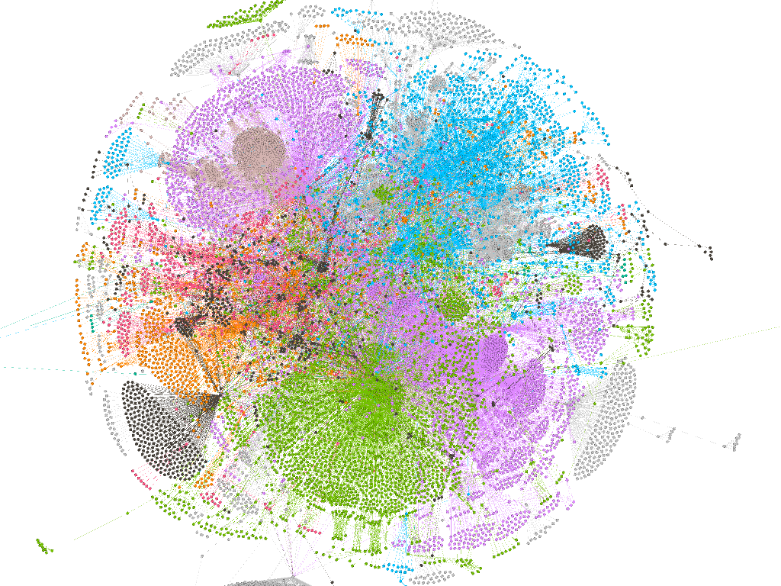
NETWORK ANALYSIS: INTRODUCTION
A network analysis identifies thematic clusters that converge across authors, topics, behaviors, and trends
Within 20K Twitter posts in the past year, we identified 5 segments that account for 68% of the conversation
*Source: Crimson Hexagon, Gephi

Slide 6
4 segments account for 62% of the conversation around health insurance competitive set
Healthcare Reform Segment: 22%
Branded Segment: 21%
Health Troubles Segment: 12%
Innovation Segment: 7%

Slide 7
Healthcare Reform Segment - Macro
This segment, the largest in the analysis, is caught up discussing the current state of U.S. healthcare, and the legislation and policies surrounding it. There is little to no brand recognition or discussion about individual coverage and plans.
#medicareforall
#singlepayer
#sb562
#singlepayersunday
#ca34
#singlepayernow
#healthcareforall
#nationalsafetymonth
#peopleoverprofit
#insurance
#mri
#saturdaymorning
The goal of much of this segment is to shine a light on troubling issues within healthcare as a whole.

Slide 8
The Functional Segment - Micro
The Functional Segment trails the Healthcare Reform Segment by 1% in conversation volume. This segment is participating in the conversation about insurers as a part of their research process. The members of this segment are
#aetna
#healthcare
#cigna
#health
#healthinsurance
#humana
#medicare
#cvs
#obamacare
#unitedhealthcare
#medical
#mentalhealth
There are 3 distinct author types in this group:
Healthcare providers
3rd party insurance marketplaces
Consumers

Slide 9
The Health Troubles Segment - Micro
Unfortunately, this segment discusses insurance through the lens of various health issues. There are several brands scattered throughout the conversation, but this is the only segment that discusses health issues.
Issues discussed by this segment include:
#cancer
#braincancer
#shame
#gbm
#healthinsurance
#innovation
#protontherapy
#bcsm
#drg
#help
#metastaticbc
#neuromodulation
Authors in this segment span a wide range, including:
Oncologists
Patients
Advocacy Groups

Slide 10
The Innovation Segment - Macro
The Innovation conversation is interestingly sprinkled through the overall conversation. This is evidenced in the visual, and supported by the fact that innovation isn’t limited to any sub-topics.
This segment presents a unique opportunity to engage with Healthcare providers and convey the value of being a part of the CareFirst network.
The innovators are discussing injecting new ideas and technology into every piece of the healthcare landscape. Technologies including:
AI
Big Data
Cloud Capabilities
Machine Learning

Slide 11
IBM Watson - Needs by Segment
Using the IBM Watson API, we determined which needs each segment indexed highest against

Slide 12
IBM Watson - Takeaways
Using the IBM Watson API, we determined which needs each segment indexed highest against

Slide 13
Implications
There is little to no discussion about CareFirst, or their competitors, outside of the Branded Segment.
Consumers aren’t spending any time discussing the merits of their providers or their individual coverage.
LiveFearless is nowhere to be found

